Slide 1
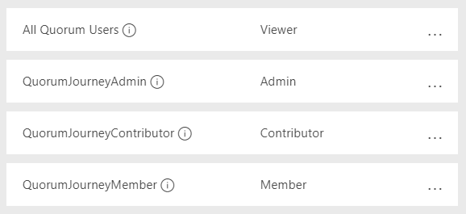
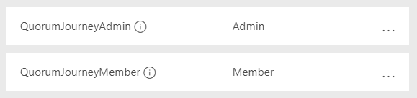




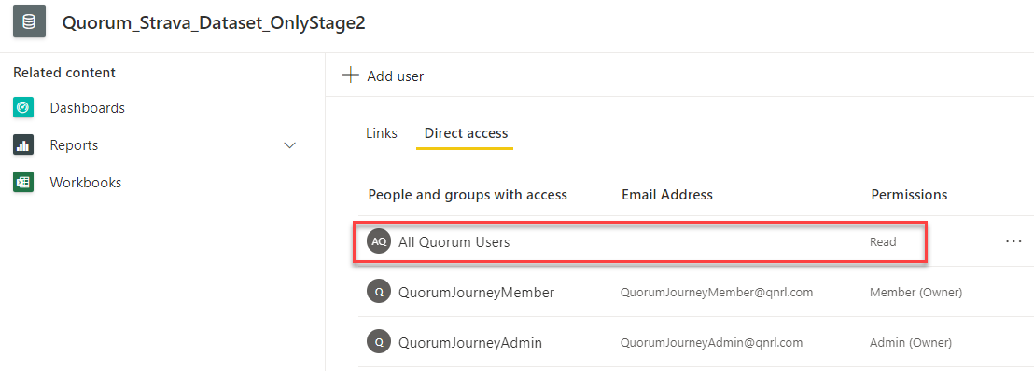
A Quorum Journey [DF]
A Quorum Journey [DS]
A Quorum Journey
Stage2
Quorum_Strava_Dataset_OnlyStage2
Darren_Test_Report
SQL Server
Data Flows
Data Sets
(NB Read access to Dataset)
Reports

